Slide 1

seq2seq +Attention
2017202053 장준혜

Slide 2
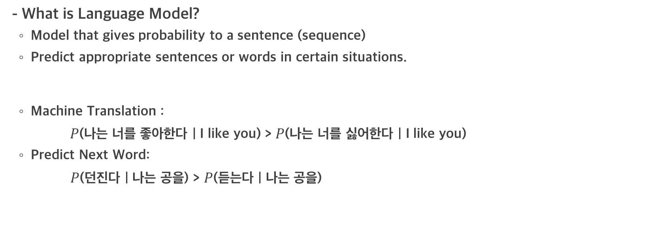
Language Model
- What is Language Model?
Model that gives probability to a sentence (sequence)
Predict appropriate sentences or words in certain situations.
Machine Translation :
$P$(나는 너를 좋아한다 | I like you) > $P$(나는 너를 싫어한다 | I like you)
Predict Next Word:
$P$(던진다 | 나는 공을) > $P$(듣는다 | 나는 공을)

Slide 3
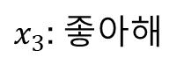
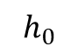
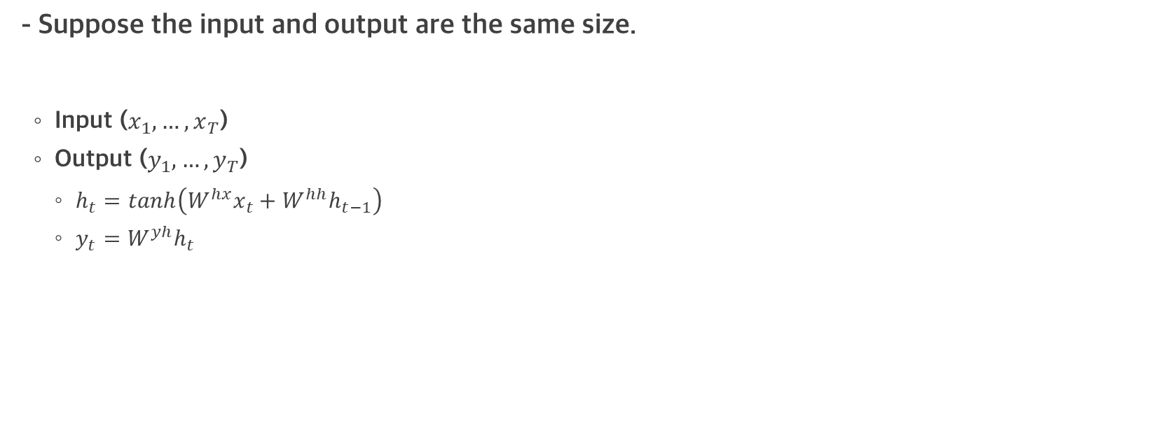
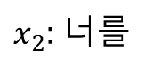
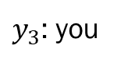
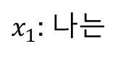
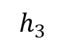
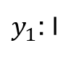
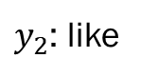
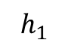
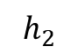
Traditional RNN-based translation process
- Suppose the input and output are the same size.
Input ($x_{1}, …,x_{T}$)
Output ($y_{1}, …,y_{T}$)
$h_{t}=tanh\left(W^{hx}x_{t}+W^{hh}h_{t−1}\right)$
$y_{t}=W^{yh}h_{t}$
$y_{1}$: I
$y_{2}$: like
$y_{3}$: you
FC
FC
FC
$$h_{1}$$
$$h_{2}$$
$$h_{3}$$
$$h_{0}$$
RNN
RNN
RNN
$x_{1}$: 나는
$x_{2}$: 너를
$x_{3}$: 좋아해

Slide 4
seq2seq
- Traditional RNN-based language models have various limitations.
To solve this, the encoder is required to extract a context vector of a fixed size.
The decoder then deduces the translation results from the context vector.
Encoder
Context Vector
Decoder

Slide 5
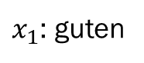
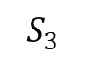
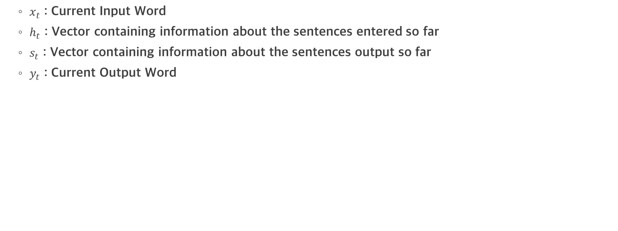
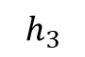
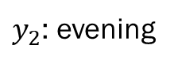
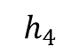
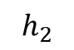
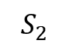
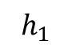
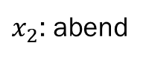
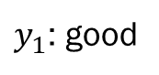
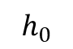
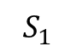
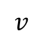
seq2seq
$x_{t}$ : Current Input Word
$h_{t}$ : Vector containing information about the sentences entered so far
$s_{t}$ : Vector containing information about the sentences output so far
$y_{t}$ : Current Output Word
Encoder
$y_{1}$: good
$y_{2}$: evening
<EOS>
FC
FC
FC
Encoder
$$h_{1}$$
$$h_{2}$$
$$h_{3}$$
$$h_{4}$$
$$S_{1}$$
$$S_{2}$$
$$S_{3}$$
RNN
RNN
RNN
RNN
Context Vector
RNN
RNN
RNN
$$h_{0}$$
<SOS>
$x_{1}$: guten
$x_{2}$: abend
<EOS>
$$v$$
<SOS>

Slide 6
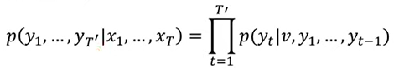
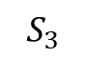
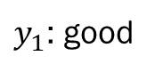
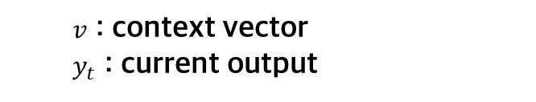
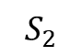
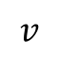
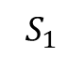
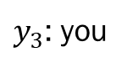
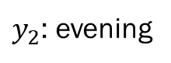
seq2seq
- Seq2Seq formulation
$y_{1}$: good
$y_{2}$: evening
<EOS>
$y_{3}$: you
FC
FC
FC
$$S_{1}$$
$$S_{2}$$
$$S_{3}$$
$v$ : context vector
$y_{t}$ : current output
Context Vector
Decoder
Decoder
Decoder
$$v$$
<SOS>
Fixed size context vector causes bottlenecks
2. The problems of long-term dependencies

Slide 7
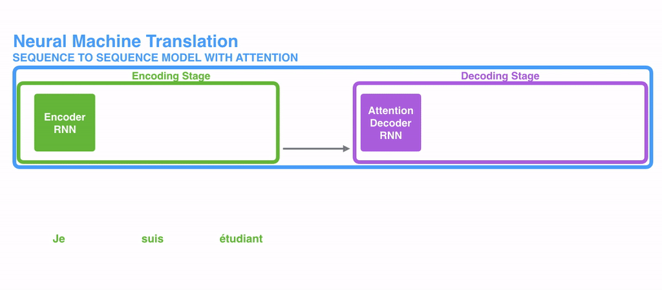
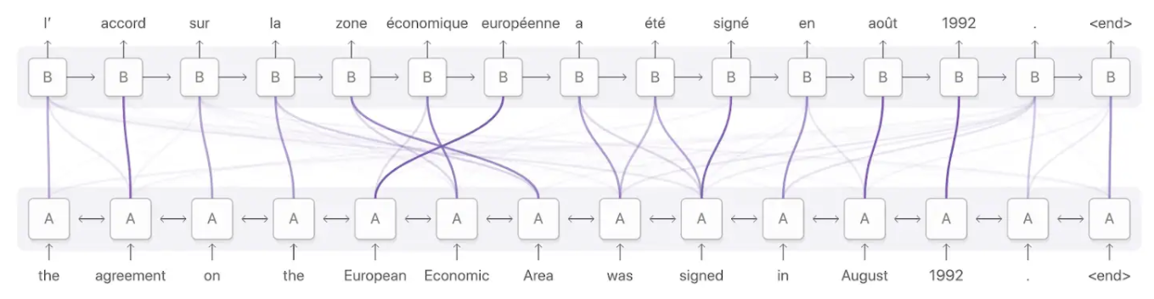
Attention

Slide 8
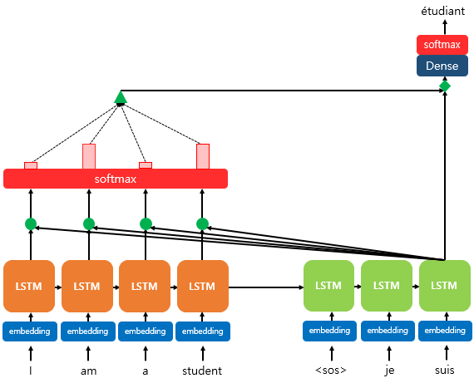
Attention
RNN
RNN
RNN
RNN
RNN
RNN
RNN

Slide 9
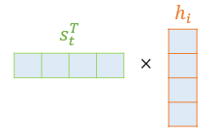
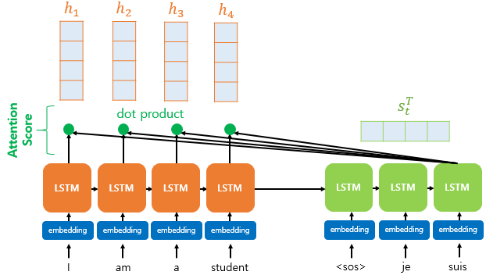
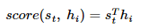
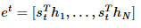
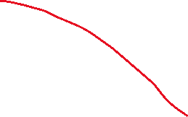
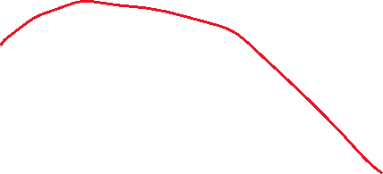
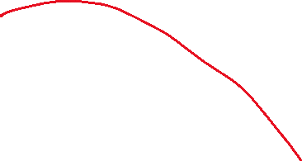
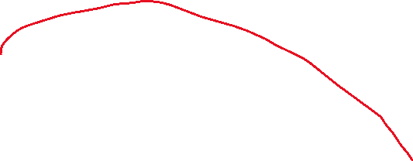
Attention : 1st step
Get Attention Score
RNN
RNN
RNN
RNN
RNN
RNN
RNN

Slide 10
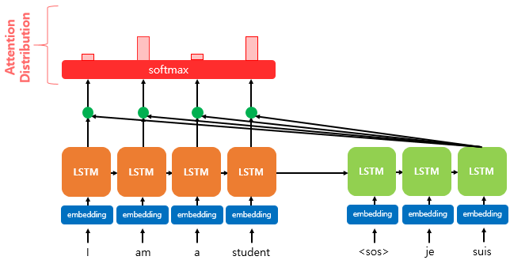
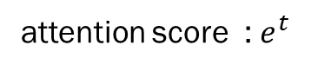
Attention : 2nd step
Get attention distribution
0.1
0.4
0.1
0.4
attention score : $e^{t}$
RNN
RNN
RNN
RNN
RNN
RNN
RNN

Slide 11
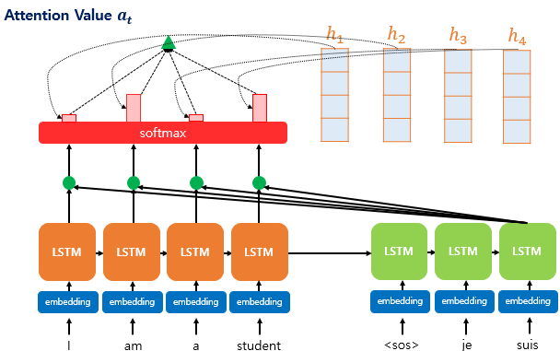
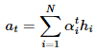
Attention : 3rd step
Get Attention Value
Often called context vector
but, different with seq2seq context vector
RNN
RNN
RNN
RNN
RNN
RNN
RNN

Slide 12



Attention : 4th step
Concatenate
Vectors entering the decoder's input
RNN
RNN
RNN

Slide 13


Attention : 5th step
Get Input of output layer operations
Weight matrix

Slide 14

Attention : 6th step
Input

